Slide 1


CityDog
Mike Young | CEO DevLab
Notes:
MICHAEL WALTON Student: 04089022
Good afternoon.
I’m Mike Young, CEO of DevLab here today to present CityDog, a new, exciting app for dog owners and an investment opportunity for you.

Slide 2

“My dog is part of my family…”
Notes:
Most pet owners in Australia consider their dogs part of the family and want to take them wherever they go.

Slide 3

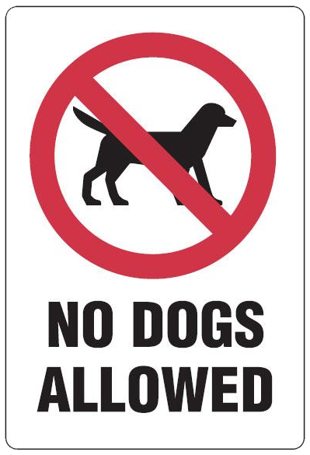
“but where can I take him?”
Notes:
The problem is dogs are not always welcome….
So how can I find out where I can I take, when I want, where I want?

Slide 4

Where can I…
…take my dog and have a coffee or bite to eat?
…walk my dog and meet other dog owners?
…get the best deals on products for my dog?
Notes:
So where can I take them if I want a coffee, and how can I meet other dog owners, and where can I buy dog food at a great price?

Slide 5

App features
Multi Platform, for Android, iPhone and Windows.
Set milestones, compete with friends and win rewards!
Find and create walking routes.
Find nearby shops, events and products that are dog friendly.
Automated and user prompted social media updates.
Notes:
Enter CityDog, the app that gives you access to this information where and when you need it.
But CityDog is more than just a directory for dog friendly cafés…It’s the complete app for dog lovers.
It’s features include:
dog walking route suggestions,
Find local shops, events and products that are dog friendly, preference given to CityDog partners.
Setting walking milestones and rewards for meeting them.
Competing with friends for weekly rankings such as “Most Frequent Walker”, “Dog’s Best Friend” (who has purchased the most through partner programs for their pet) and “Food Lover” for visiting the most partner cafés and restaurants.
Automated social media updates each time the app registers an event such as taking the dog for a walk or visiting a partner café or event.
User prompted social media, post pictures of your dog and engage in CityDog tagged chat online.
Targeted advertising, showing the user information when and where it’s need to help get a sale.hitting milestones and visiting new locations. It’ll even tell you where you can find that new pink walking lead you’ve been after, locally.
Multi-platform driven codebase, allow for easy multiplatform development using out of the box tools like PhoneGap.

Slide 6
Market overview
92%
have a
smartphone
$3.6B
spent on dogs in 2009
Market opportunity
Australians spend a lot of money on keeping their canine family member happy.
How do we get in on the action?
3.4 million dogs
Notes:
Australian Bureau of statistics reported in 2013 that there 11.2 million smartphone users in Australia, with 92% of over 18’s having a smartphone.
In 2009 Australians owned 3.41 million dogs and spent 3.6 billion dollars on them. The average Australian spent $1056 on their dog in 2009.

Slide 7
Market analysis
36%
that’s 16 dogs for every 100 people!
60%
of a whopping $6.02 billion pet industry was spent on dogs alone in 2009.
of households own dogs
of industry spend
Notes:
36% of Australian households own a dog, that’s 16 dogs for every 100 people!
In 2009 Australians spent $3.6 billion on their dogs, accounting for 60%

Slide 8
Asia-Pacific market
$1,056
Average annual dog owner’s spend on their pet
Australia
4%
$1,571
Average annual dog owner’s spend on their pet
New Zealand
growth
50.8%
Japan’s share of Asia-Pacific market
USD $11.3
Japan
billion
43.8%
share of total Asia Pacific market
dog care
Notes:
If we look to Asia Pacific there has been a 4% overall growth in the pet product and service industry, worth 11.3 billion US in 2012.
Over 50% of this market is in Japan so international expansion should target this country.
Closer to home, New Zealand is also noteworthy, with 63% of households owning pets, the largest in the world, and dog owners spending $1571 a year on their pet.
References:
Australian Companion Animal Council report (July 2011)
New Zealand Companion Animal Council report (2010)

Slide 9
Revenue streams
Lead Generation
Advertising
Partner Programs
Referrals
Users of the app form a leads database which can be sold to pet product providers and lead resellers.
Targeted advertising within CityDog and partner apps, delivered at the right moment.
Direct partnerships with pet industry leaders will generate revenue through commission and targeted advertising campaigns.
Referral programs provide revenue if a customer downloads or purchases a partner app.
Notes:
Target partners are those responsible for the largest pet industry market share, namely dog food manufacturers, vetinerary services, insurance providers and accessory manufacturers (check these against market report).
Referral partnerships such as Upsight (who now own Playhaven) help boost downloads of apps and create revenue when CityDog users download other apps.
Check lecture notes for their definition of revenue streams

Slide 10
Marketing strategy
Merchandise
Distributed through industry events, dog groups and dog parks.
Reviews
10%
40%
User and professional reviews are key to getting noticed for any app.
10%
Printed Media
Traditional printed media distributed at partner cafes, restaurants and events.
20%
20%
Social Media
Auto-posting of user activity to Facebook, Twitter and other social media hubs.
Referrals
In-app advertising of CityDog in referral partner apps.
Notes:
Online, in-app (other apps) referral programs, events at dog parks, partner programs (in window advertising / sticker)
Facebook posts!
Customer relationships are formed through social media, CityDog website updates and in app rewards and notifications.
Digital marketing/branding will include website

Slide 11
Product delivery
Idea
3 month trial
Market analysis
Create base product, test market.
Partner Relationships
Marketing campaign
Foster partner relationships, draw up agreements.
Minimum viable
product
Iterate & innovate
End Goal
Continue to refine features and improve revenue streams.
Expansion
Target revenue reached, CityDog top ranked pet application.
Notes:
We are at the 3 month trial phase with a basic product.
We need to build the multi-platform product, foster relationships with partners and kick off the marketing campaign.
As an app development house we have the resources to build the technical product and with investment can build partner relationships and create a marketing campaign to launch from.

Slide 12
Investment
Development 40%
30% Marketing
$ 500 000
Partners 20%
10% Reserve
Notes:
How your investment will be leveraged for success.
The primary spend will be in development of the application itself. This includes implementing feature set and targeted advertising for Android and iPhone markets.
Marketing the app effectively will require a 30% portion of the investment. The focus will be on digital marketing, through peer review, social media and targeted advertising campaigns. Traditional media will also have it’s place in the cafés, shops and parks that dog owners frequent.
Finally, fostering partner relationships and drawing up agreements will require a smaller but significant slice of the investment.

Slide 13
Contact
Mike Young | CEO
+ 61 7 3234 1234
citydogapp
citydog@devlab.com.au
twitter.com/citydogapp
facebook.com/citydogapp
pinterest.com/citydogapp

